Slide 1
ADA Boosting regression
Boosting Performance with Adaptive Learning

Slide 2
Definition
Key Characteristics
AdaBoost (Adaptive Boosting) is an ensemble learning technique that aims to improve the performance of weak learners by combining them into a strong learner.
Sequential training of weak models
Weights assigned to each data point
Emphasis on misclassified data

Slide 3
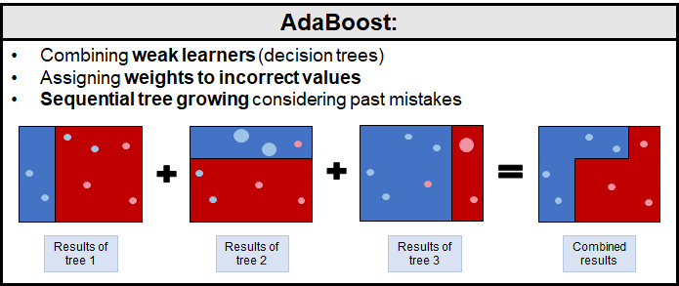
AdaBoost WORKING METHOD
Step 1: Train a weak model on the entire dataset.
Step 2: Increase the weights of misclassified data points.
Step 3: Train a new weak model with adjusted weights.
Step 4: Repeat steps 2 and 3 until a specified number of weak models are created.
Step 5: Combine the weak models to form a strong model.

Slide 4
ADVANTAGE
Improved Accuracy: AdaBoost focuses on the most challenging data points, leading to better overall accuracy.
Versatility: Suitable for various types of weak learners and can be applied to different types of data.
Reduced Overfitting: AdaBoost tends to generalize well, reducing the risk of overfitting compared to individual weak models.

Slide 5
Syntax
from sklearn.ensemble import AdaBoostRegressor
n_estimators (default=50), learning_rate (default=1.0) are the 2 varying parameters for AdaBoostregressor function

